Slide 1

GDL_Phase2

Slide 2
Dataset
Trainset: consists of 2 Folders
Down Syndrome Images : 142 image.
Normal Images: 116 images.
Validation set: consists of 2 Folders
Down Syndrome Images : 10 image.
Normal Images: 10 images.
Test set: 10 images (mixture of normal and Down Syndrome images)

Slide 3
Deep Learning Algorithm Using PyTorch
1-Using LeNet_CNN.
2-Using LeNet_CNN after applying Data Augmentation.
3- Using Complex Architecture after applying Data Augmentation.

Slide 4
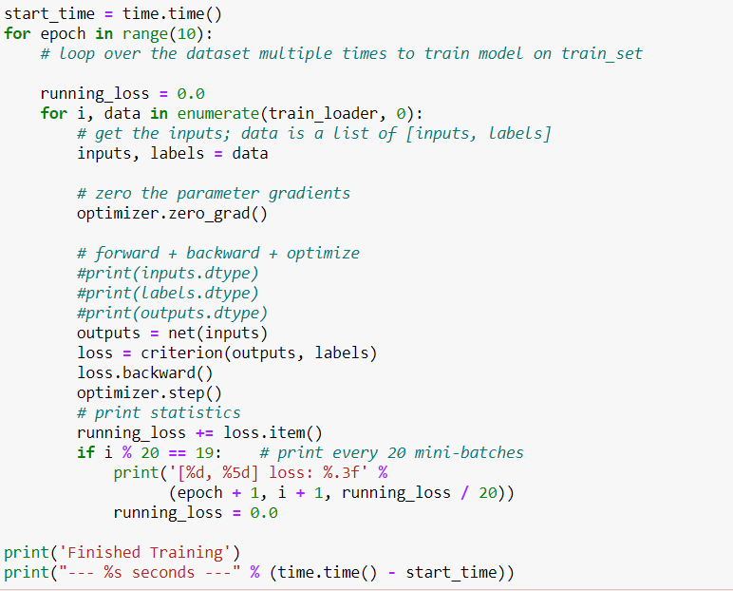
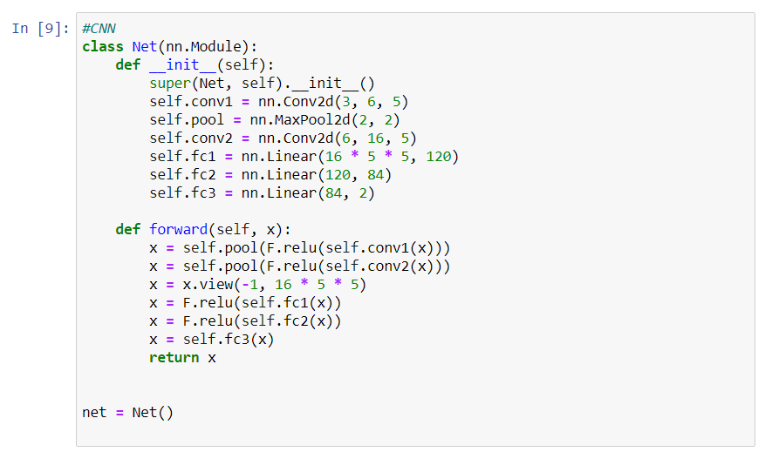
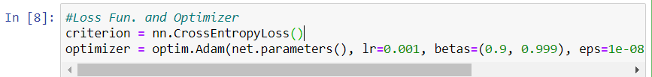
1- LeNet_CNN .

Slide 5
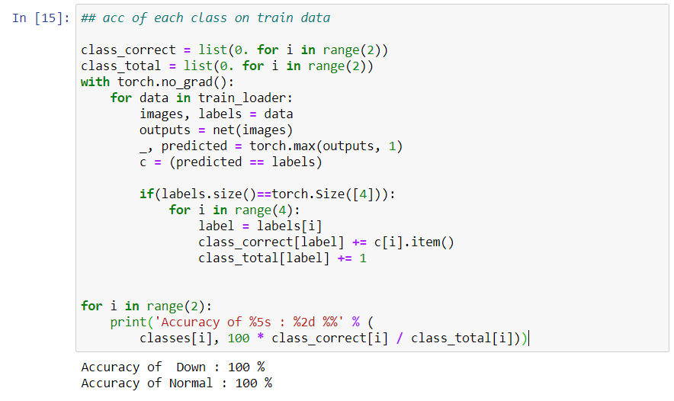
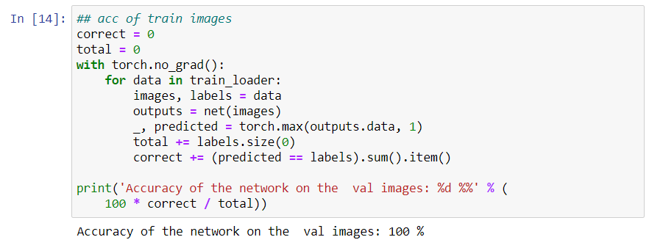
Accuracy of Trainset

Slide 6
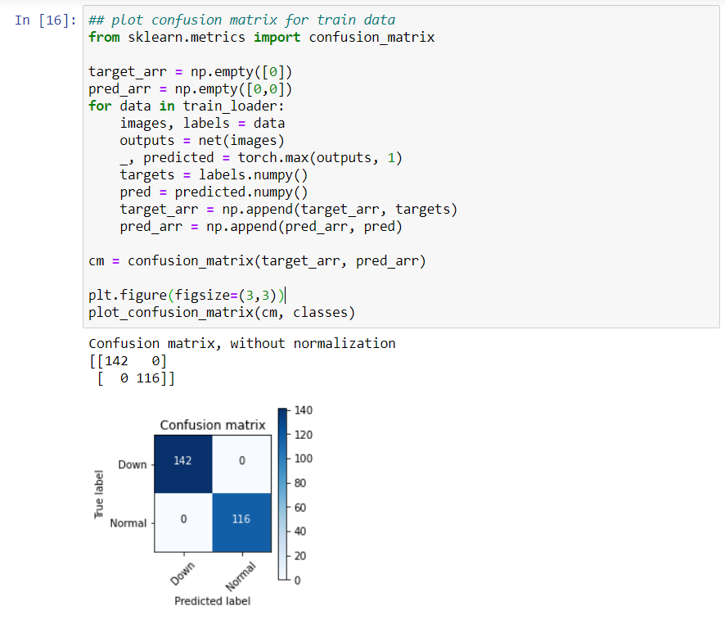
Confusion Matrix

Slide 7
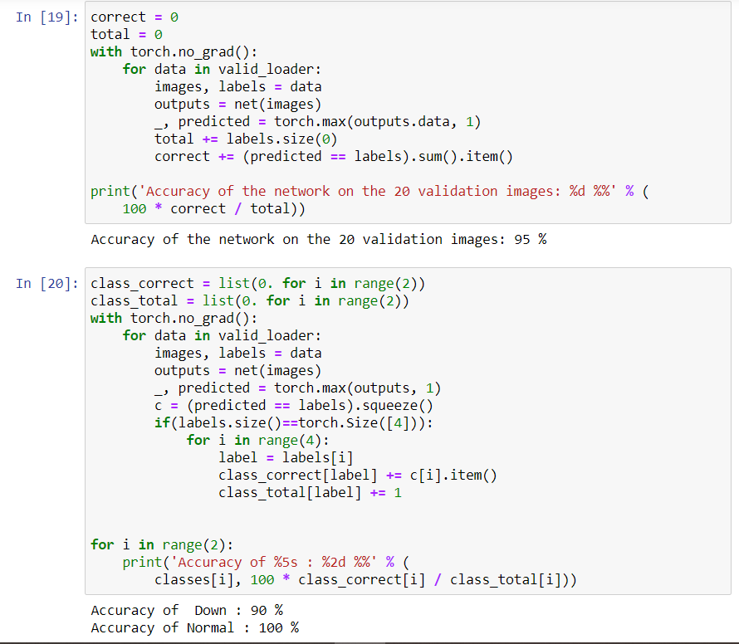
Validation set Accuracy
Notes:
Overfitting so we think to make data augmentation

Slide 8
Data Augmentation
It is a technique of increasing the size of data used for training a model. For reliable predictions, the deep learning models often require a lot of training data, which is not always available. Therefore, the existing data is augmented in order to make a better generalized model.
https://iq.opengenus.org/data-augmentation/

Slide 9
Common Data Augmentation Techniques
Position augmentation
Scaling
Cropping
Flipping
Padding
Rotation
Translation
Affine transformation
Color augmentation
Brightness
Contrast
Saturation
Hue
https://iq.opengenus.org/data-augmentation/

Slide 10
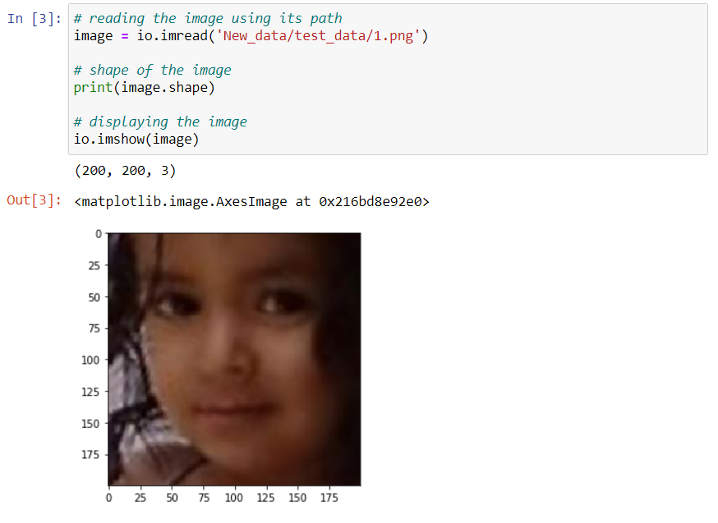
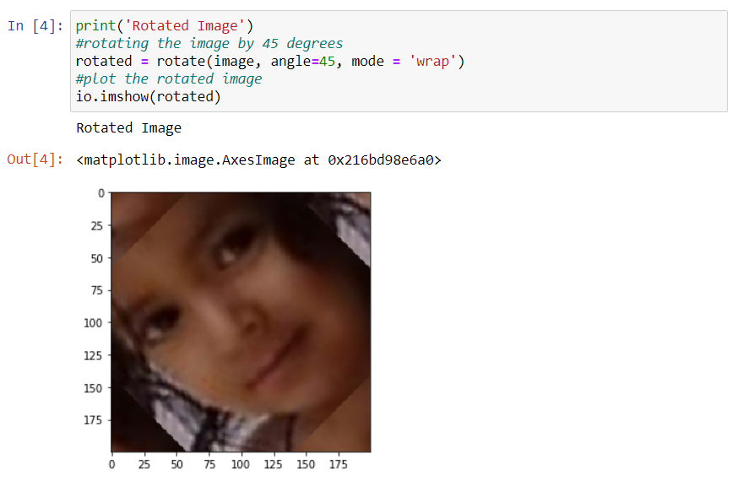
Rotation Technique Example in PyTorch
Original Image Rotated Image

Slide 11
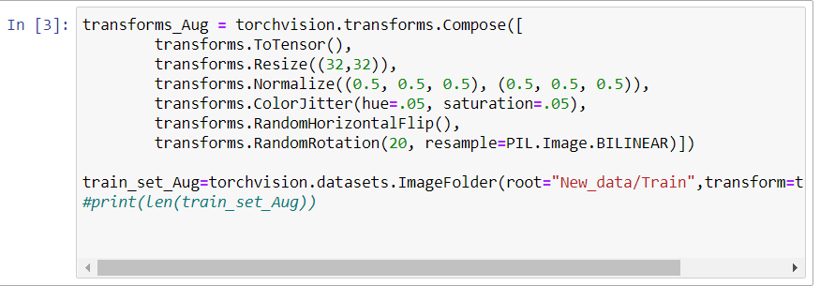
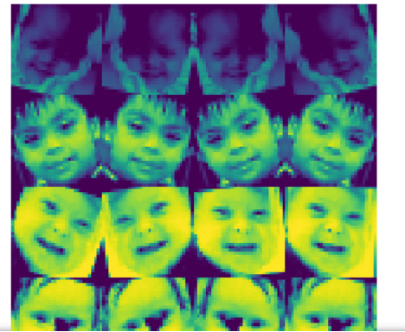
2- Apply Data Augmentation with Le-Net CNN
https://colab.research.google.com/drive/109vu3F1LTzD1gdVV6cho9fKGx7lzbFll

Slide 12
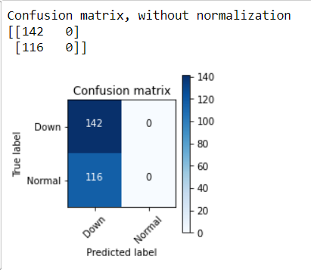

Trainset accuracy

Slide 13


Validation set accuracy

Slide 14
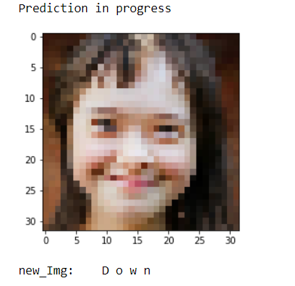
Test new image

Slide 15
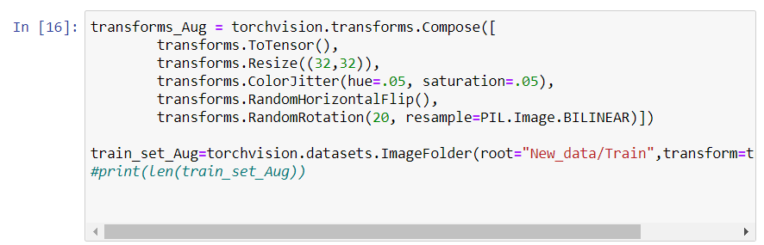
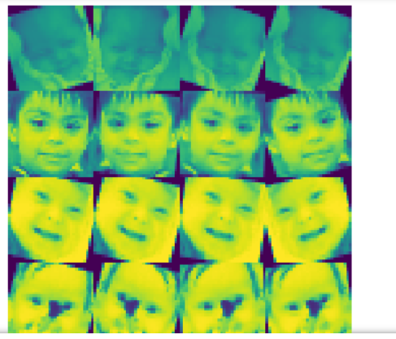
2- Apply Data Augmentation with Le-Net CNN
Notes:
Remove normalization

Slide 16
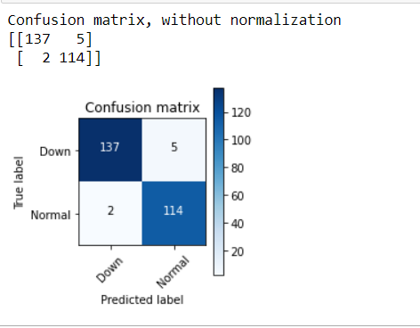

Trainset accuracy

Slide 17


Validation set Accuracy

Slide 18
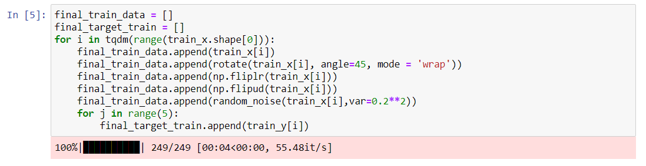
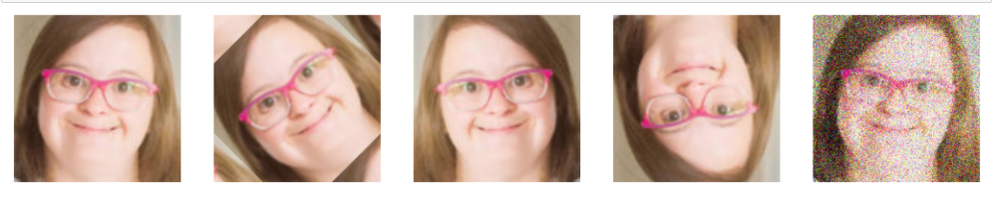
3-Apply Data Augmentation with Complex Architecture
https://www.analyticsvidhya.com/blog/2019/12/image-augmentation-deep-learning-pytorch/

Slide 19
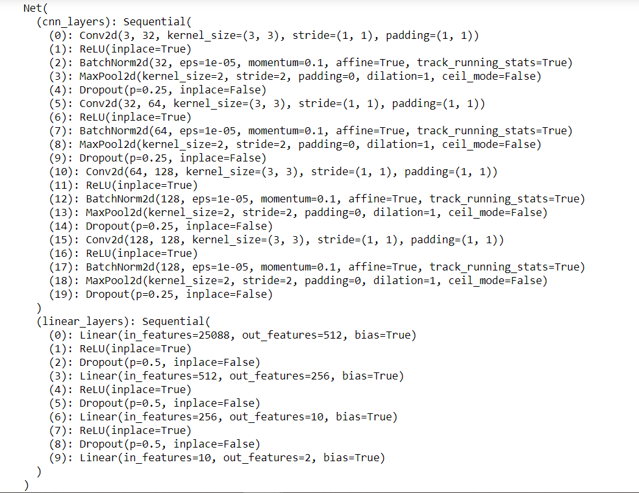
Complex Architecture

Slide 20

Trainset accuracy

Slide 21

Validation set Accuracy

Slide 22
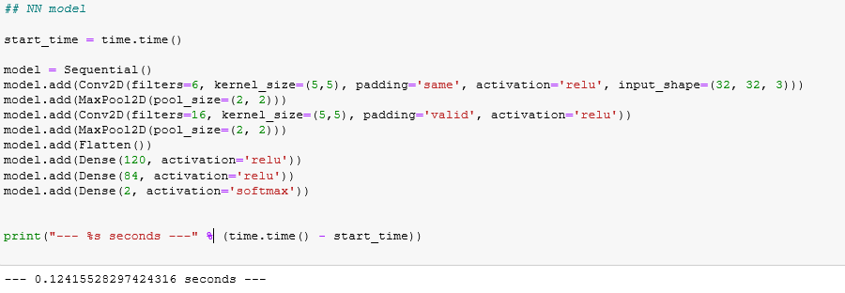
Deep Learning Algorithm Using TensorFlow
LeNet 5 :

Slide 23
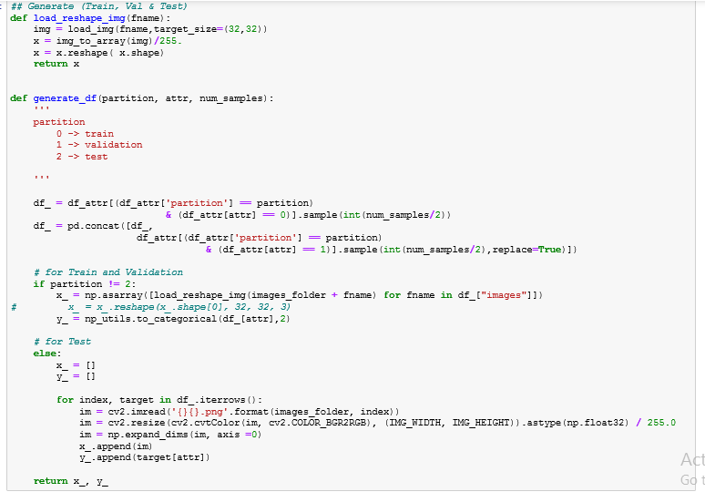
Train, Validation & Test Split

Slide 24
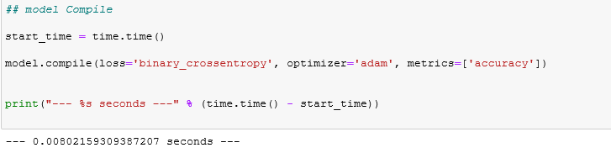
Compiling & optimization

Slide 25
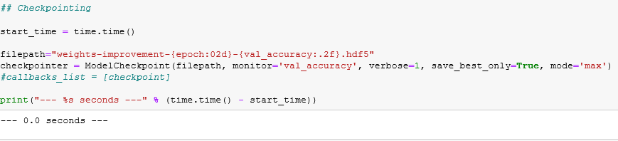
Model Save & Checkpointing

Slide 26
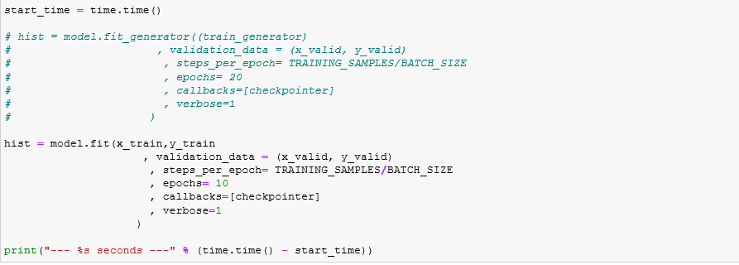
Model Fit & Training

Slide 27
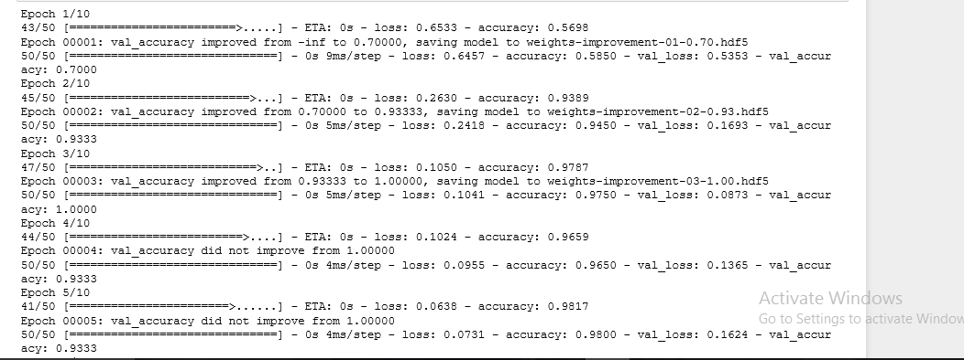
Model Train Summary

Slide 28
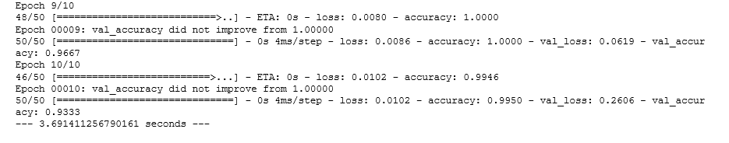

Slide 29
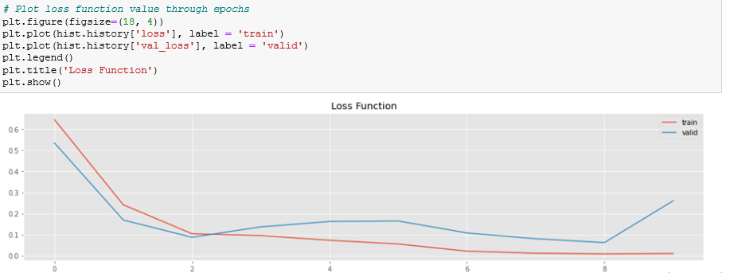
Loss Chart

Slide 30
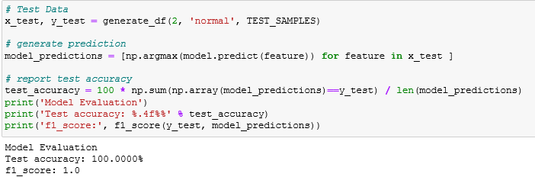
Prediction of Test set

Slide 31
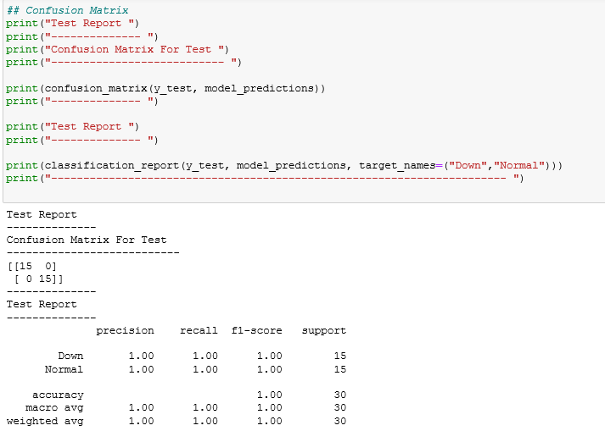
Test Set Reporting

Slide 32
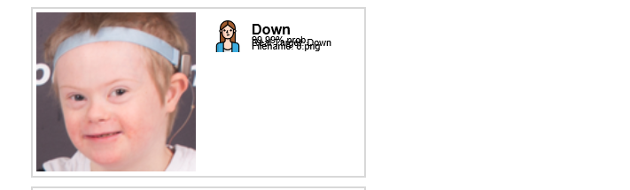

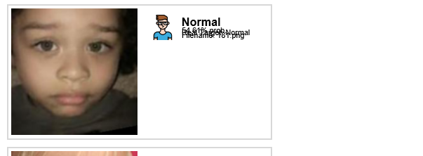

Test Set Prediction Visualize

Slide 33
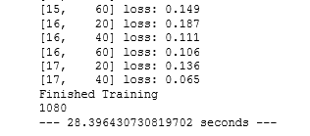
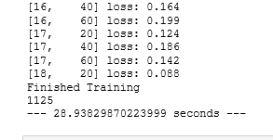
Color VS Gray Images
Gray
Color

Slide 34


Train
Color
Gray

Slide 35
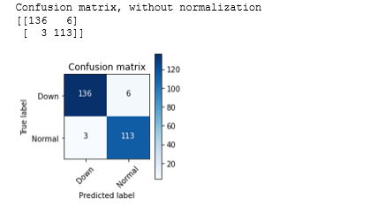
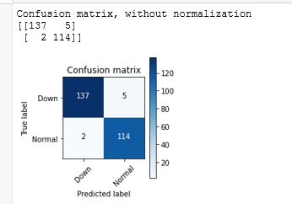
Train
Color
Gray

Slide 36


Test
Color
Gray

Slide 37
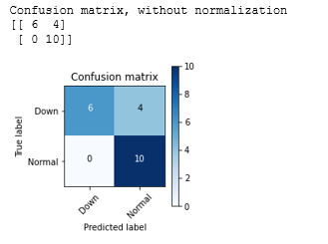
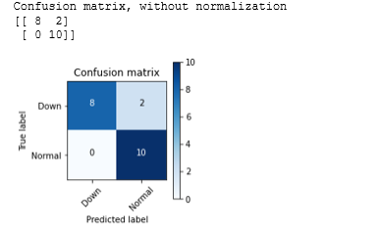
Test
Color
Gray

Slide 38
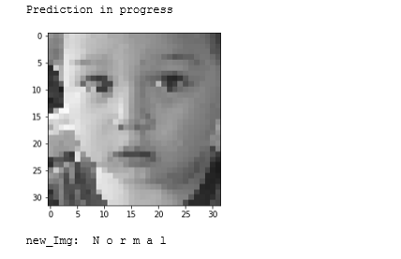
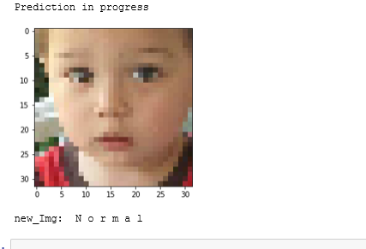
Example
Color
Gray

